Slide 1
Selenium
Page Object Model
LEVEL – PRACTITIONER
Notes:
Welcome to the session on Selenium – Page Object Model

Slide 2
Page Object Model: Overview
Introduction:
Prerequisites for understanding Page Object Model (POM)
Issues with Selenium scripting without using POM
Advantages of POM
Structure and Implementation of POM
Notes:
Here is a brief overview on the topics to be covered in this session:
Prerequisites for understanding Page Object Model (POM)
Issues with Selenium scripting without using POM
Advantages of POM
Structure and Implementation of POM

Slide 3
Objectives
After completing this module, you will be able to understand the:
Need for Page Object Model
Advantages of Page Object Model
Structure of Page Object Model
Page Object Model Implementation
Notes:
On completing this session, you will be able to understand the following :
Need for Page Object Model
Advantages of Page Object Model
Structure of Page Object Model
Implementation of Page Object Model

Slide 4
Prerequisites
Knowledge on
Automation basics
Java Programming with Java SE 6.0
Selenium Tool
Software predominantly used to try hands on for POM
Selenium Webdriver
Java
Eclipse Ide
TestNG
Reporting software – Log4j
Notes:
Below are the prerequisites that one would require before attempting to work on Page Object Model.
Knowledge on
Automation basics
Java Programming with Java SE 6.0
Selenium Tool
Software predominantly used to try hands on for POM
Selenium Webdriver
Java
Eclipse Ide
TestNG
Reporting software – Log4j

Slide 5
Need for Page Object Model
Below are the issues one would face while scripting in Selenium without using Page Object Model
There would be no separation between the test method and the AUT’s (Application Under Test) locators
If different objects have been used in multiple scripts, then even if one object changes all scripts have to be changed
Performance issues could arise with keyword driven framework to load heavy excel sheets to drive test script
Notes:
If Page Object Model is not used while scripting in Selenium tool, one might face the below mentioned issues:
There would be no separation between the test method and the AUT’s (Application Under Test) locators
If different objects have been used in multiple scripts, then even if one object changes all scripts have to be changed
Performance issues could arise with keyword driven framework to load heavy excel sheets to drive test script

Slide 6
Introduction to Page Object Model
Page Object Model is a design pattern that can be implemented using selenium webdriver
Page-Object pattern is one of the most effective approaches for creating a Test Automation Framework
It is an object-oriented class that serves as an interface to a page of AUT. The tests then use the methods of this page object class whenever they need to interact with the UI of that page
Often the functionality of AUT is repeated across test scripts through same definitions leading to redundancy in code and hence Code becomes huge
Notes:
So, what is Page Object Model?
Page Object Model is a design pattern that can be implemented using selenium webdriver
Page-Object pattern is one of the most effective approaches for creating a Test Automation Framework
It is an object-oriented class that serves as an interface to a page of AUT. The tests then use the methods of this page object class whenever they need to interact with the UI of that page
Often the functionality of AUT is repeated across test scripts through same definitions leading to redundancy in code and hence code becomes huge

Slide 7
Advantages of Page Object Model
Extensible: Object Repository of the fields segmented page-wise can be created, as a Page Repository of the application. Each page will be defined as a java class. All the fields in the page will be defined in an interface as members. The class will then implement the interface
Functional Encapsulation: All possible functionality or operations that can be performed on a page can be defined and contained within the same class created for each page. This allows for clear definition and scope of each page's functionality
Maintainable: Any User Interface changes can swiftly be implemented into the interface as well as class. There is a single repository for the services or operations offered by the page
Notes:
Lets look at the advantages of using Page Object Model:
Extensible: Object Repository of the fields segmented page-wise can be created, as a Page Repository of the application. Each page will be defined as a java class. All the fields in the page will be defined in an interface as members. The class will then implement the interface
Functional Encapsulation: All possible functionality or operations that can be performed on a page can be defined and contained within the same class created for each page. This allows for clear definition and scope of each page's functionality
Maintainable: Any User Interface changes can swiftly be implemented into the interface as well as class. There is a single repository for the services or operations offered by the page

Slide 8
Advantages of POM (contd..)
Programmer Friendly: Robust and more readable. The Object-oriented approach makes the framework programmer friendly
Low Redundancy: Helps reduce duplication of code. If the architecture is correctly and sufficiently defined, the POM gets more done in less code
Efficient & Scalable: Faster than other keyword-driven/data-driven approaches where Excel sheets are to be read/written
Readable: There is a clean separation between test code and page specific code such as locators (or their use if you’re using a UI Map) and layout. So can be easily interpreted by the business stakeholders
Notes:
Programmer Friendly: Robust and more readable. The Object-oriented approach makes the framework programmer friendly
Low Redundancy: Helps reduce duplication of code. If the architecture is correctly and sufficiently defined, the POM gets more done in less code
Efficient & Scalable: Faster than other keyword-driven/data-driven approaches where Excel sheets are to be read/written
Readable: There is a clean separation between test code and page specific code such as locators (or their use if you’re using a UI Map) and layout. So can be easily interpreted by the business stakeholders

Slide 9
Structure of POM framework
Web Page
Application Under Test
Page Class(s)
Test Cases
Reports
Page Class Base Methods
a) UI Object level
b) Function level
A page object is an object-oriented class that serves as an interface to a page of the AUT
The tests then use the methods of this page object class whenever they need to interact with that page of the UI
All shared controls or methods should be put in a base page class
Results from the tests get published in the form of reports for each test execution
Notes:
Lets us look at the Structure of POM framework:
A page object is an object-oriented class that serves as an interface to a page of the AUT
The tests then use the methods of this page object class whenever they need to interact with that page of the UI
All shared controls or methods should be put in a base page class
Results from the tests get published in the form of reports for each test execution

Slide 10
Implementation of Page Object Model
Creating Page Objects for our test application - For each web page create a base page class. All control locators for that page should be put in this class
Creating methods that perform actions on the Page Objects
Create tests that perform the required actions and execute the required checks - All test logic and verifications should be put in test classes
Run the tests as TestNG tests (optional) and inspect the results
All shared controls or methods should be put in a base page class
A Page class need not necessarily represent an entire page. It could be used to represent components on a page like frames
Notes:
During the planning phase for the test automation, identify the below:
number of pages in the application.
number of objects in each page of the application
appropriate locators for each object
all actions to be performed on these objects
test cases to be automated and prepare test suites for all test cases
Once the above steps are planned, one should proceed with
Creating Page Objects for our test application - For each web page create a base page class. All control locators for that page should be put in this class
Creating methods that perform actions on the Page Objects
Creating tests that perform the required actions and execute the required checks - All test logic and verifications should be put in test classes
Running the tests as TestNG tests (optional) and inspect the results
All shared controls or methods should be put in a base page class
A Page class need not necessarily represent an entire page. It could be used to represent components on a page like frames

Slide 11
Let us consider an example
To demonstrate the implementation of above mentioned POM framework, we will consider a case study on the website http://demo.borland.com/InsuranceWebExtJS, wherein we will work on creating
Page Objects
Methods
Tests
Notes:
To demonstrate the implementation of above mentioned POM framework, we will consider a case study wherein we will work on creating
Page Objects
Methods
Tests
We will implement Page Object Model for the case study under consideration by following the steps discussed in the previous slide.

Slide 12
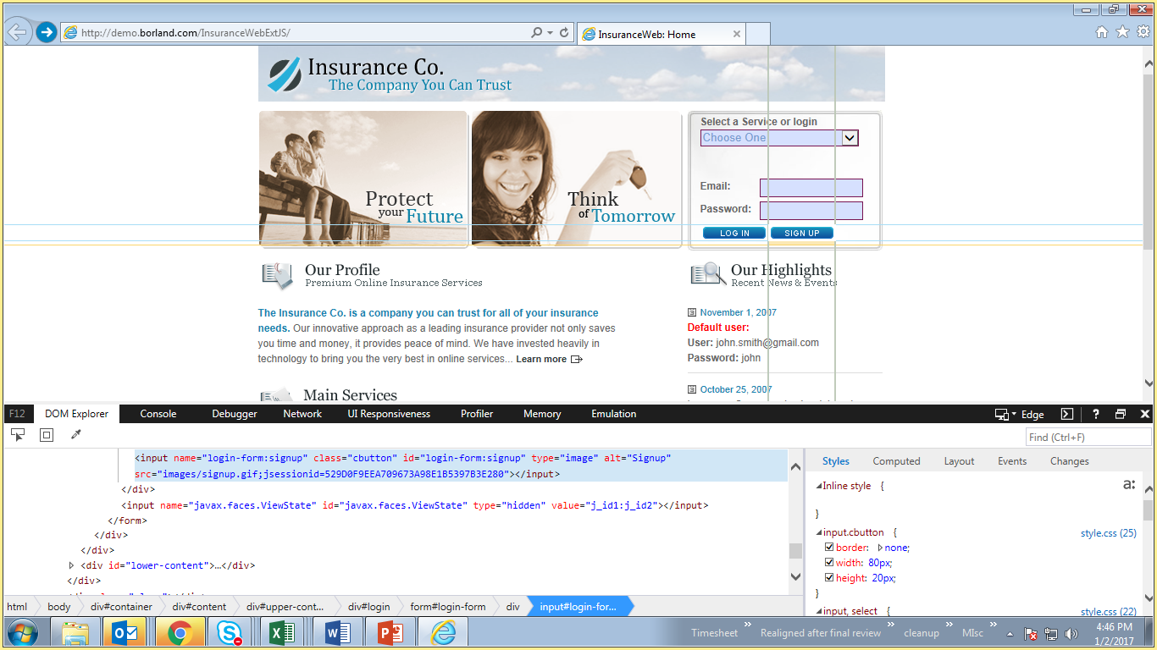
Step 1: Create Page Objects
Step 1: Creating Page Objects for test application
public class HomePage extends Helper{
//Declaration
String strPgTitle = "InsuranceWeb: Home";
//****Page Object locators declaration*******
By BTN_Login = By.id("login-form:login");
By BTN_SignUp = By.id("login-form:signup");
By LST_QuickJumpMenu = By.id("quick-link:jump-menu");
//****Page class constructor********
public HomePage()
{
try
{
VerifyText("InsuranceWeb: Home", driver.getTitle());
System.out.println("Home Page is loaded Successfully");
}
catch (Exception e)
{
System.out.println("Home Page is not loaded Successfully");
}
}
}
Notes:
Lets go step by step in creating a page object.
For each web page in the application, create a class (ex: HomePage class ). At the same time a page object need not necessarily represent an entire single UI page, i.e., more number of page objects can be created for a single page. You may need to plan for number of classes for each page in the application.
In each page object, identify all the objects to be stored in that class. In this example we have declared 3 objects in the page object class by name - BTN_Login, BTN_SignUp, LST_QuickJumpMenu. Identify correct object locator for each UI and create page object elements for each.
There is one, single, verification which can be within the page object and that is to verify that the page, and possibly critical elements on the page, were loaded correctly (ex., HomePage method). This verification should be done while instantiating the page object. In the example given, the try catch block verifies the page.

Slide 13
Step 2: Create methods
Step 2: Create methods that perform the required actions and executes the required checks
public void fn_HomepgElementsvalidation()
{
try
{
isElementPresent(BTN_Login);
isElementPresent(BTN_SignUp);
System.out.println("Home Page validtion is Successfull");
}
catch (Exception e)
{
System.out.println("Home Page validtion is not Successfull "+e.getMessage());
}
}
public void fn_HomepgClickSignUp()
{
try
{
clickElement(BTN_SignUp, "Sign up button");
}
catch (Exception e)
{
System.out.println("Home Page Signup button is not clicked Successfully "+e.getMessage());
}
}
Notes:
Lets learn how to create methods on all page objects.
Identify and list all possible functionalities on this page and write a separate method for each of the functionality. When there is a click event, you have to return driver object of new page.
Ideally these methods can be of 2 types
a) UI object level method which acts on a single object to perform a single action (ex., fn_HomepgClickSignUp)
b) Functional method where multiple object level methods are combined together to perform a single transaction (ex., fn_HomepgElementsvalidation)

Slide 14
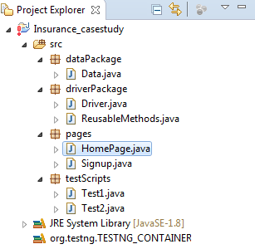
Step 3: Create tests
Step 3: Create tests that perform the required actions and execute the required checks
package testScripts;
import org.testng.annotations.Test;
import driverPackage.Driver;
import driverPackage.ReusableMethods;
import pages.HomePage;
public class Test1 extends Driver{
@Test
public void Teststeps()
{
Launchapp();
HomePage homePg = new HomePage();
homePg.fn_HomepgElementsvalidation();
homePg.fn_HomepgClickSignUp();
}
}
Notes:
To prepare tests based on page objects, create your test suite using TestNG annotation @Test as displayed in the above example.
Please find out a sample structure as in picture.

Slide 15
Case Study
Let us consider a case study for a “Sample Insurance” website to purchase an Auto (Car) insurance quote.
The embedded word document will give you a scenario to try hands on with POM. It also contains the solution pertaining to it in order for you to validate your code against the already available code.

Slide 16
Summary
In this course we discussed on the below
Need for Page Object Model
Advantages of using POM
Structure of POM
Implementation of POM
Sample Case study
Notes:
The summary of the learning is displayed here.

Slide 17

References
http://roadtoautomation.blogspot.in/2015/02/page-object-model-for-selenium-webdriver.html
http://www.guru99.com/page-object-model-pom-page-factory-in-selenium-ultimate-guide.html
https://www.kainos.pl/blog/building-automation-framework-by-example-1-the-first-tests/
Disclaimer: Parts of the content of this course is based on the materials available from the Web sites and books listed above. The materials that can be accessed from linked sites are not maintained by Cognizant Academy and we are not responsible for the contents thereof. All trademarks, service marks, and trade names in this course are the marks of the respective owner(s).
Notes:
These are the source for reference.

Slide 18
You have successfully completed
Selenium – Page Object Model
Thank You !
Notes:
You have successfully completed Selenium – Page Object Model. Thank you !!

